Slide 1

Sequential Circuit Analysis
Circuit Diagram to State Diagram
State Diagram to Circuit Diagram
Counters
Application of Counters

Slide 2
What is sequential logic
Sequential circuit has additional dimension which is time
Combinational logic only depends on current input
Sequential circuit output depends on previous input other than current input
More powerful than combination logic
Able to model condition which can’t be modeled by combinational logic

Slide 3
Circuit Diagram to State Diagram

Slide 4
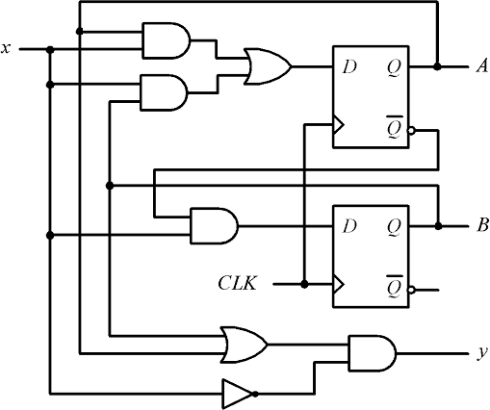
Example 1: Draw the state diagram for the given circuit
Sequential circuit using D flip flop
Present States:
A and B
Next States:
A+ and B+
Input:
DA, DB, x
Output:
y

Slide 5
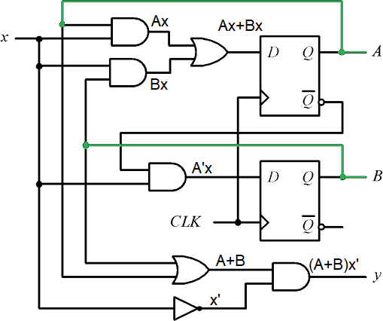
Example 1: Draw the state diagram for the given circuit
1. Find out the input equations of the flip flop and the output equation
DA = Ax + Bx
DB = A’x
y = (A+B)x’

Slide 6



Example 1: Draw the state diagram for the given circuit
A |  |  | B |  |  | x |  |  |  | DA | DB | y
0 |  |  | 0 |  |  | 0 |  |  |  | 0 | 0 | 0
0 |  |  | 0 |  |  | 1 |  |  |  | 0 | 1 | 0
0 |  |  | 1 |  |  | 0 |  |  |  | 0 | 0 | 1
0 |  |  | 1 |  |  | 1 |  |  |  | 1 | 1 | 0
1 |  |  | 0 |  |  | 0 |  |  |  | 0 | 0 | 1
1 |  |  | 0 |  |  | 1 |  |  |  | 1 | 0 | 0
1 |  |  | 1 |  |  | 0 |  |  |  | 0 | 0 | 1
1 |  |  | 1 |  |  | 1 |  |  |  | 1 | 0 | 0
2. Construct the state table according to the flip flop input and output equations
DA = Ax + Bx
DB = A’x
y = (A+B)x’
When A=0, B=0, x=0, DA = 0.0 + 0.0 = 0
DB = 0’.0 = 0
y = (0+0).0’ = 0
When A=0, B=0, x=1, DA = 0.1 + 0.1 = 0
DB = 0’.1 = 1
y = (0+0).1’ = 0

Slide 7

Example 1: Draw the state diagram for the given circuit
A | B | x |  | DA | DB | y |  | A+ | B+
0 | 0 | 0 |  | 0 | 0 | 0 |  | 0 | 0
0 | 0 | 1 |  | 0 | 1 | 0 |  | 0 | 1
0 | 1 | 0 |  | 0 | 0 | 1 |  | 0 | 0
0 | 1 | 1 |  | 1 | 1 | 0 |  | 1 | 1
1 | 0 | 0 |  | 0 | 0 | 1 |  | 0 | 0
1 | 0 | 1 |  | 1 | 0 | 0 |  | 1 | 0
1 | 1 | 0 |  | 0 | 0 | 1 |  | 0 | 0
1 | 1 | 1 |  | 1 | 0 | 0 |  | 1 | 0
A+
B+
3. Find out the next states from the flip flop input values
D Flip-flop Truth table
∴ DA = A+
∴ DB = B+

Slide 8

Example 1: Draw the state diagram for the given circuit
A | B | x |  | A+ | B+ | y
0 | 0 | 0 |  | 0 | 0 | 0
0 | 0 | 1 |  | 0 | 1 | 0
0 | 1 | 0 |  | 0 | 0 | 1
0 | 1 | 1 |  | 1 | 1 | 0
1 | 0 | 0 |  | 0 | 0 | 1
1 | 0 | 1 |  | 1 | 0 | 0
1 | 1 | 0 |  | 0 | 0 | 1
1 | 1 | 1 |  | 1 | 0 | 0
4. Draw the state diagram from the state table
0/0
1/0
10
0/1
00
0/1
1/0 0/1
1/0
1/0
01
11
State Diagram

Slide 9
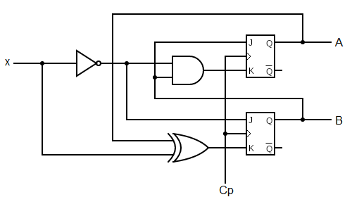
Example 2: Draw the state diagram for the given circuit
Sequential circuit using JK flip flop
Sequential circuit using JK flip flop
Present States:
A and B
Next States:
A+ and B+
Input:
JA, KA, JB, KB, x

Slide 10
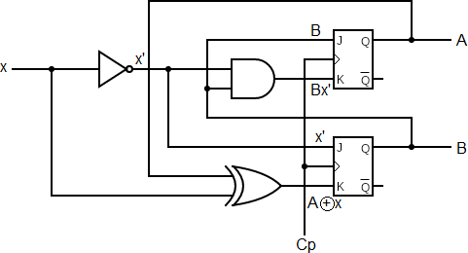
Example 2: Draw the state diagram for the given circuit
1. Find out the input equations of the flip flop and the output equation
JA = B KA = Bx’ JB = x’
KB = A xor X

Slide 11
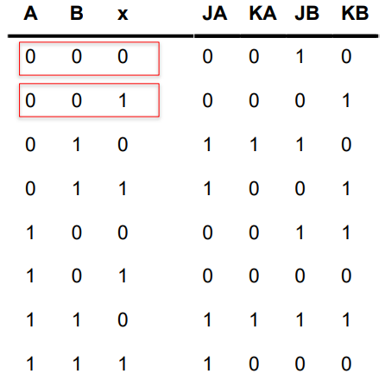
Example 2: Draw the state diagram for the given circuit
2. Construct the state table according to the flip flop input and output equations
JA = B KA = Bx’ JB = x’
KB = A xor X
When A=0, B=0, x=0, JA = 0
KA = 0.0’ = 0
JB = 0’ = 1
KB = 0 xor 0 = 0
When A=0, B=0, x=1, JA = 0
KA = 0.1’ = 0
JB = 1’ = 0
KB = 0 xor 0 = 0

Slide 12
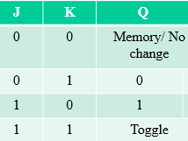
Example 2: Draw the state diagram for the given circuit
A | B | x |  | JA | KA | JB | KB |  | A+ | B+
0 | 0 | 0 |  | 0 | 0 | 1 | 0 |  | 0 | 1
0 | 0 | 1 |  | 0 | 0 | 0 | 1 |  | 0 | 0
0 | 1 | 0 |  | 1 | 1 | 1 | 0 |  | 1 | 1
0 | 1 | 1 |  | 1 | 0 | 0 | 1 |  | 1 | 0
1 | 0 | 0 |  | 0 | 0 | 1 | 1 |  | 1 | 1
1 | 0 | 1 |  | 0 | 0 | 0 | 0 |  | 1 | 0
1 | 1 | 0 |  | 1 | 1 | 1 | 1 |  | 0 | 0
1 | 1 | 1 |  | 1 | 0 | 0 | 0 |  | 1 | 1
3. Find out the next states from the flip flop input values
JK Flip-flop Truth table

Slide 13

Example 2: Draw the state diagram for the given circuit
A | B | x |  | A+ | B+
0 | 0 | 0 |  | 0 | 1
0 | 0 | 1 |  | 0 | 0
0 | 1 | 0 |  | 1 | 1
0 | 1 | 1 |  | 1 | 0
1 | 0 | 0 |  | 1 | 1
1 | 0 | 1 |  | 1 | 0
1 | 1 | 0 |  | 0 | 0
1 | 1 | 1 |  | 1 | 1
4. Draw the state diagram
from the state table
1 1
0
00 11
0 0
0
1
01 10
1
State Diagram

Slide 14
State Diagram to Circuit Diagram

Slide 15
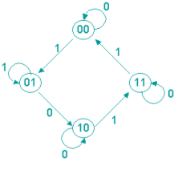
Design: Example 1
Given state diagram as follows, get the sequential circuit using JK flip-flop

Slide 16
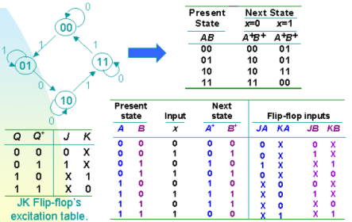
Design: Example 1
Note: Step 1: Build state table
Step 2: Find no. of Flip-Flop (i.e. 2^m states means m flip-flips)
Step 3: Build Excitation table
Step 4: Use K-map to find input functions
Step 5: Design logic diagram
State/excitation table using JK flip-flop

Slide 17
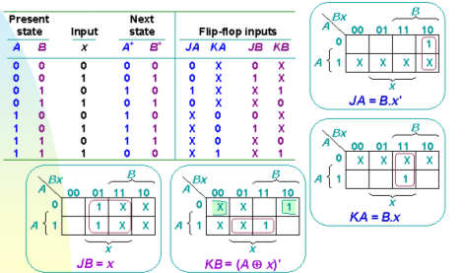
Design: Example 1
From state table, get input flip-flop function

Slide 18
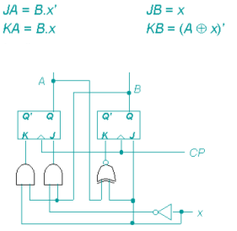
Design: Example 1
Input flip-flop function
Logic Diagram

Slide 19
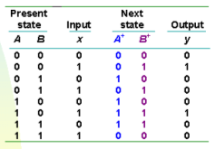
Design: Example 2
Design, using D flip-flop, circuit is based on state table below. (Exercise: How if using JK flip-flop)

Slide 20
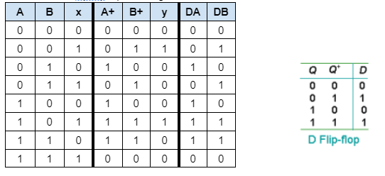
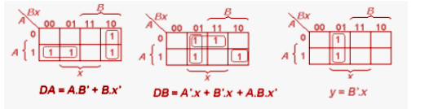
Design: Example 2
Determine input expression for flip-flop and y output

Slide 21
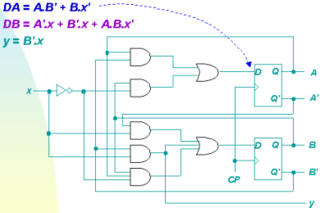
Design: Example 2
From expression built, draw logic diagram

Slide 22
Introduction: Counters
Counters are circuits that cycle through a specified number of states.
Two types of counters:
synchronous (parallel) counters
asynchronous (ripple) counters
Ripple counters allow some flip-flop outputs to be used as a source of clock for other flip-flops.
Synchronous counters apply the same clock to all flip-flops.
We will cover only synchronous this time

Slide 23
Synchronous (Parallel) Counters
Synchronous (parallel) counters: the flip-flops are clocked at the same time by a common clock pulse.
We can design these counters using the sequential logic design process.
Example: 2-bit synchronous binary counter (using T flip-flops, or JK flip-flops with identical J,K inputs).

Slide 24
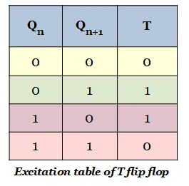
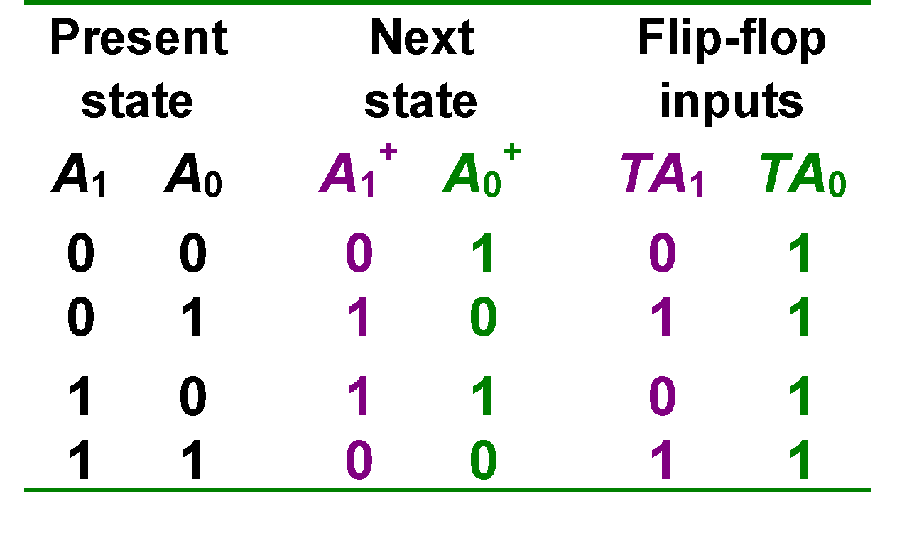
Synchronous (Parallel) Counters
Question: Design a 2-bit synchronous binary counter (using T flip-flops).
Start by drawing this
00
01
11
10

Slide 25
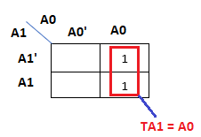
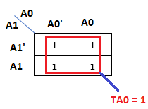
Synchronous (Parallel) Counters
Next, find out the equations for the flip-flop inputs.
TA₁ = A₁’A₀ + A₁A₀ = A₀ (A₁’+A₁) = A₀
TA₀ = 1
FYI, these can also be calculated using K-Maps
0

Slide 26
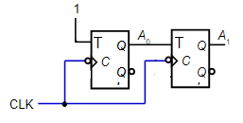
Synchronous (Parallel) Counters
TA₁ = A₁’A₀ + A₁A₀ = A₀ (A₁’+A₁) = A₀
TA₀ = 1
Finally draw the circuit diagram

Slide 27
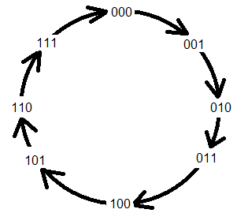
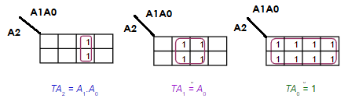
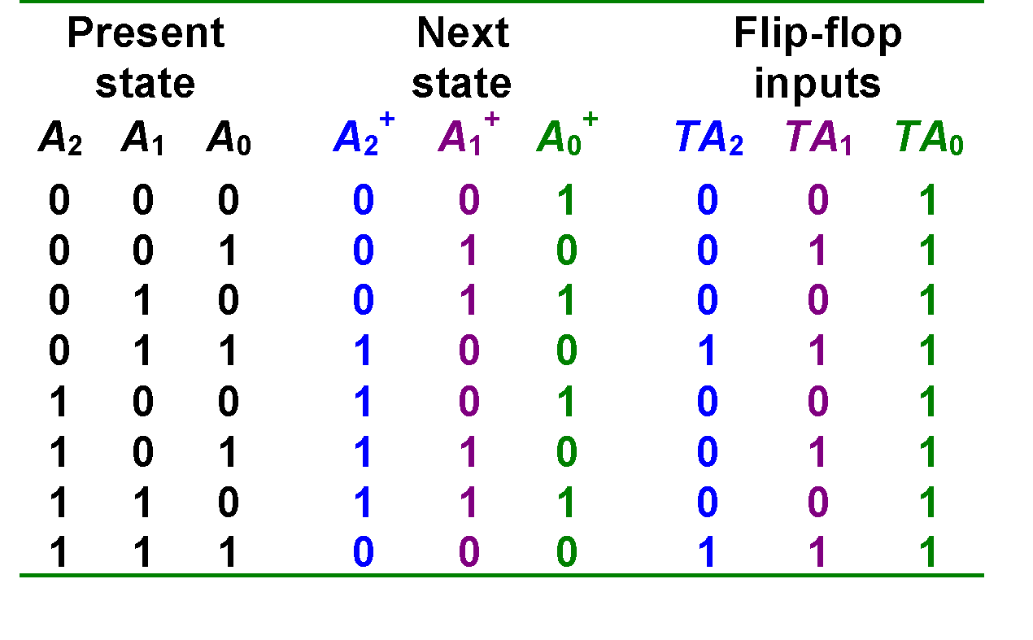
Synchronous (Parallel) Counters
Start by drawing this
Question: Design a 3-bit synchronous binary counter (using T).
FYI, these can also be calculated using Boolean simplifications

Slide 28
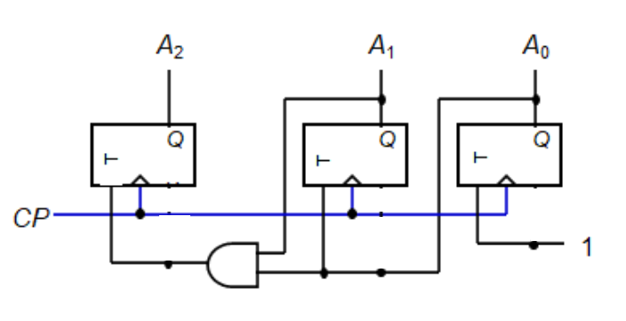
Synchronous (Parallel) Counters
Draw the circuit diagram
TA₂ = A₁.A₀ TA₁ = A₀ TA₀ = 1

Slide 29
Self-Study
4 bit synchronous up counter
Equations and diagram will look like the following:
TA₃ = A₂ . A₁ . A₀
TA₂ = A₁ . A₀
TA₁ = A₀
TA₀ = 1
1
A₁.A₀
A₂.A₁.A₀
J
A₀
J
A₁
J
A₂
J
A₃
Q
Q
Q
Q
Q
C
C
C
C
Q'
K
Q'
K
Q'
K
Q'
K
Q'
CLK

Slide 30
Up/Down Synchronous Counters
Up/down synchronous counter: a bidirectional counter that is capable of counting either up or down.
An input (control) line Up/Down (or simply Up) specifies the direction of counting.
Up/Down = 0 → Count upward
Up/Down = 1 → Count downward

Slide 31
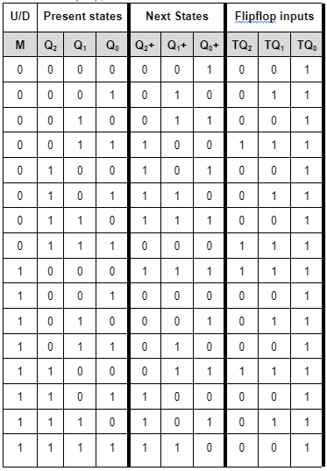
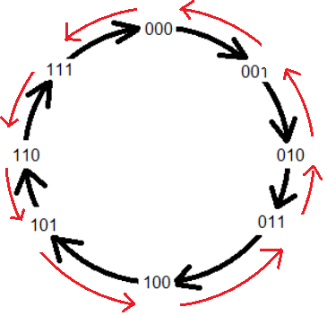
3 bit Synchronous Up/Down Counter
https://www.youtube.com/watch?v=svFUEJkoeVY&list=PLBlnK6fEyqRjMH3mWf6kwqiTbT798eAOm&index=189

Slide 32
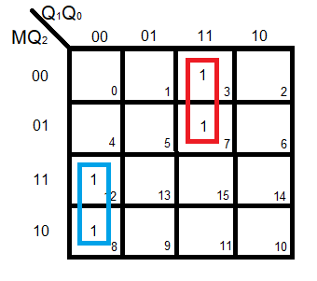
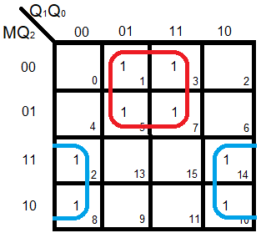
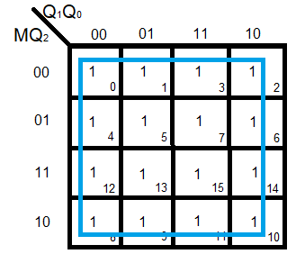
3 bit Synchronous Up/Down Counter
TQ₁ = M’Q₀ + MQ₀’
TQ₂ = M’Q₁Q₀ + MQ₁’Q₀’
TQ₀ = 1
https://www.youtube.com/watch?v=svFUEJkoeVY&list=PLBlnK6fEyqRjMH3mWf6kwqiTbT798eAOm&index=189

Slide 33
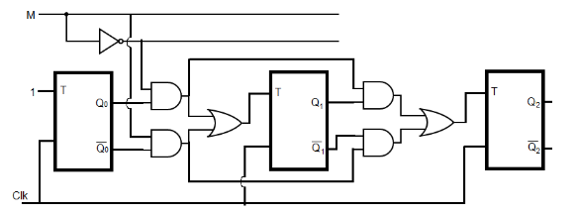
3 bit Up/Down Synchronous Counter
Draw the circuit diagram
(The number of present state will be equal to the number of flip-flops in the circuit)
https://www.youtube.com/watch?v=svFUEJkoeVY&list=PLBlnK6fEyqRjMH3mWf6kwqiTbT798eAOm&index=189

Slide 34
Practice Problem using Counters

Slide 35
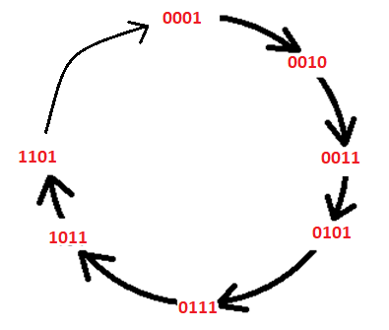
PRACTICE PROBLEM - 1
Implement the following counter using T FF: 1->2->3->5->7->11->13->1
Start by drawing this

Slide 36
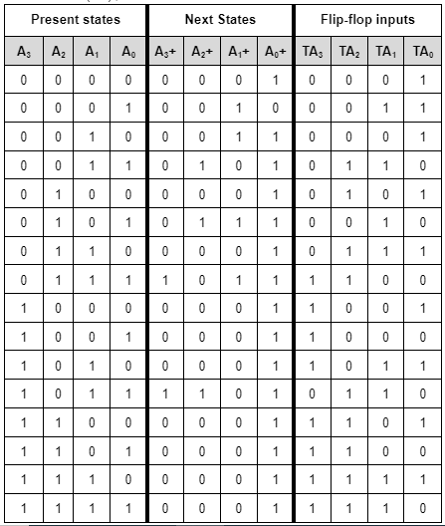
For present states not mentioned in the question, next state will be the INITIAL STATE [0001 in this question]. It’s important to show the states that are not mentioned in the question.Otherwise, the circuit will stop working if any of those states show up.

Slide 37
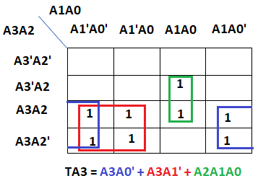
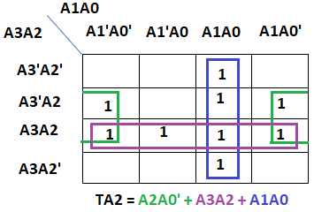

Slide 38
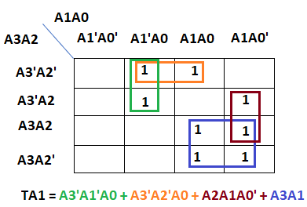
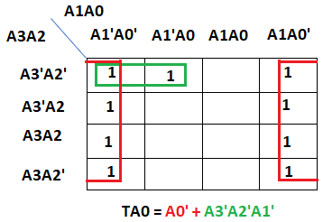

Slide 39
Draw the circuit yourself

Slide 40
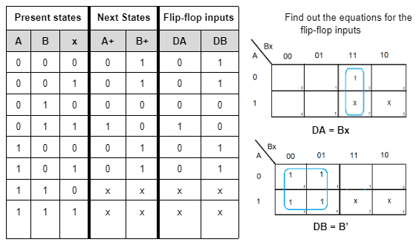
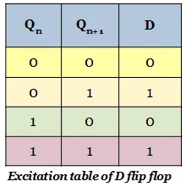
PRACTICE PROBLEM - 2
Implement the following counter using D FF: Green->Yellow->Red->Yellow->Green
Let’s assume: Green = 00, Yellow = 01, Red = 10

Slide 41
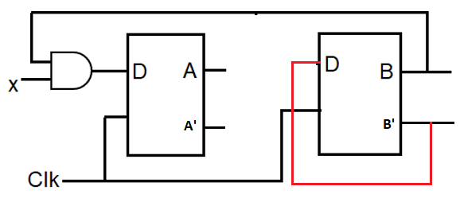
Draw the circuit diagram (The number of present state will be equal to the number of flip-flops in the circuit)

